Slide 1
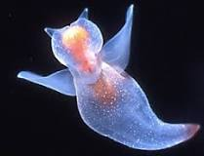
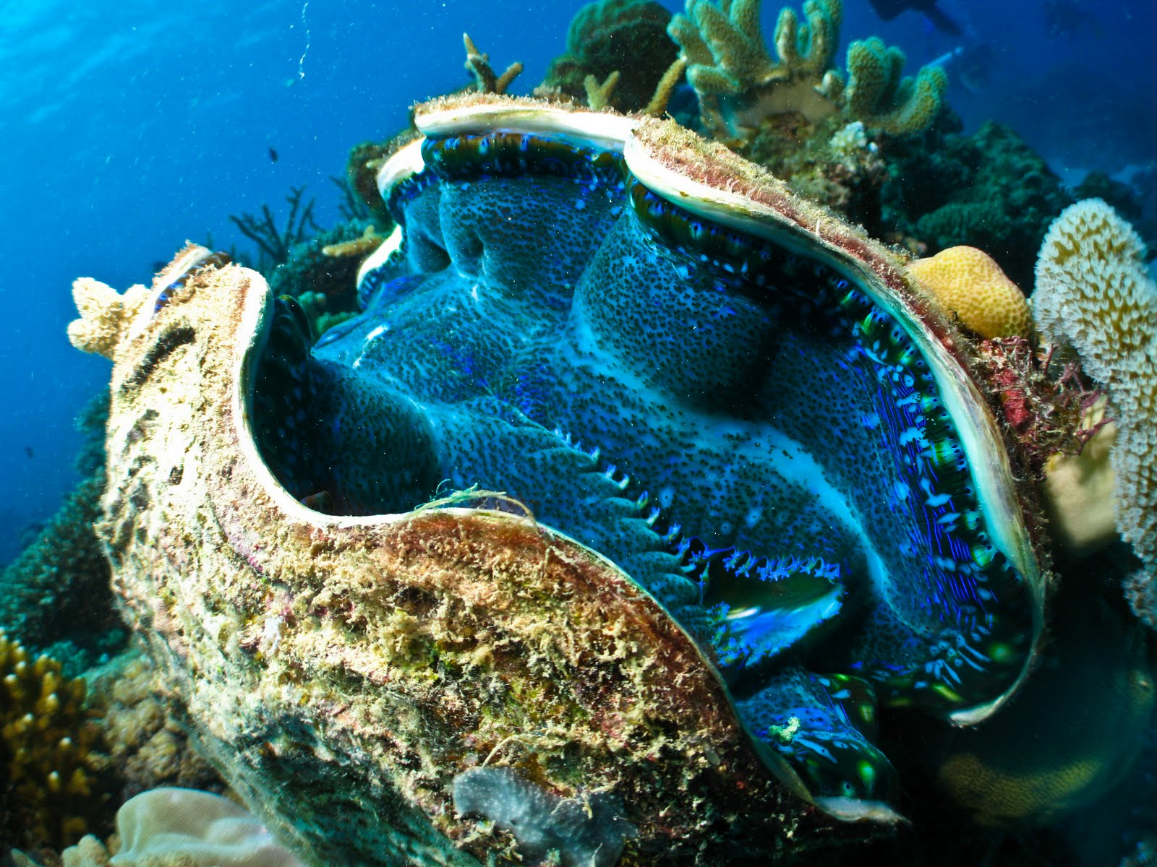
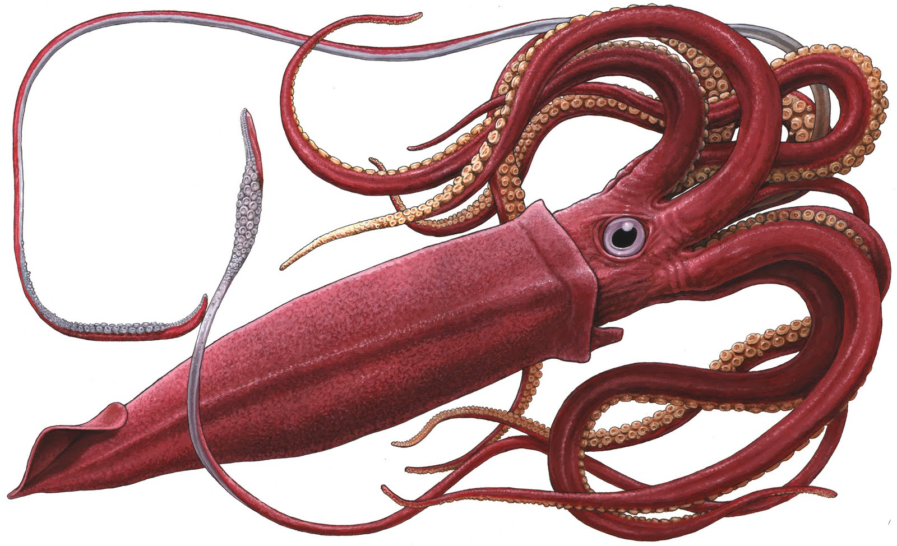
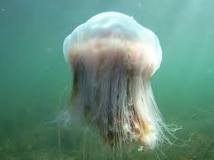
Mollusca
by: Brandon Yu, Tony Nilsen, Leo Buoncristiani, and Anthony Allen

Slide 2
Giant Clam
By: Tony Nilsen

Slide 3
Giant Clam
Part of the phylum mollusca, the Giant is the largest bivalve on Earth, capable of reaching up to 4 feet in length and up to 500 pounds. Giant clams achieve their enormous proportions by consuming the sugars and proteins produced by the billions of algae that live in their tissues. They use a siphon to draw in water to filter and consume passing plankton too. Surprisingly, giant clams have considerable mobility, ranging from swimming and gliding as larvae to crawling in adulthood. Due to their shell weight or byssal attachment, adult giant clams are unable to escape rapidly from threats using locomotion so instead, they use multiple anti-predator behaviors that include sudden contraction of the mantle, valve adduction, and squirting of water.
size comparison of a 6 foot man

Slide 4
Clione
By Brandon Yu

Slide 5
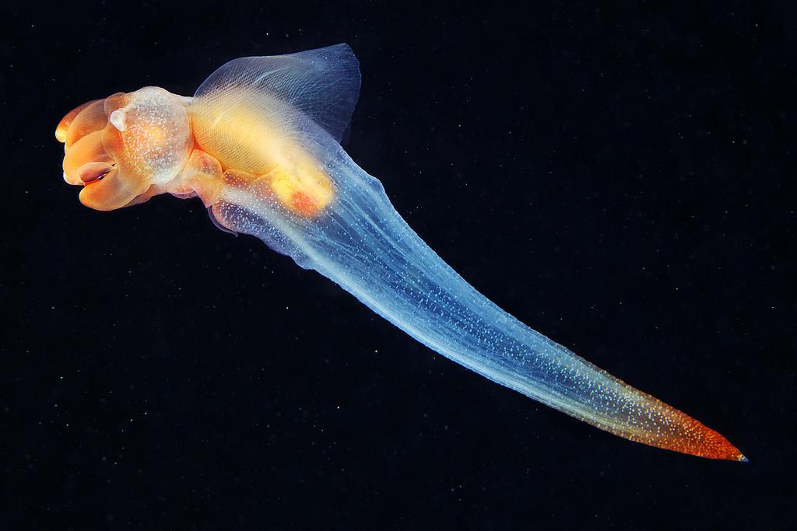
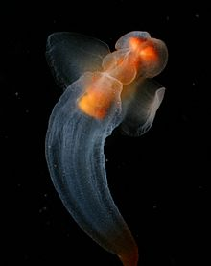
Clione
A Clione is a sea snail that has no shell. It is sometimes also known as the sea butterfly. Clione’s have really flexible wings. Clione has a constant slow swimming behavior and a fast swimming behavior used for escape and hunting. When they swim quickly you can see a significant increase in wing velocity and angle of attack, and range of motion increases as the wings bend more during fast swimming. Their wingbeat is very consistent.

Slide 6
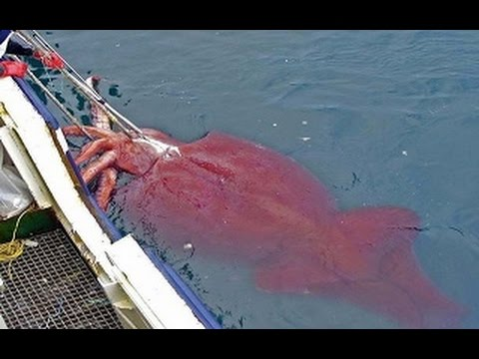
Giant Squid Eyes
Leo Buoncristiani

Slide 7
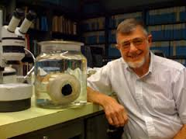
Giant Squid Eyes
Eye diameter is proportional to the ability to see a certain distance. When the eye is larger its ability to absorb light is increased.“Although other squid species generally have large eyes for their body size, the allometric growth factor for smaller squid is below 0.7 [26], making the eyes of giant and colossal squid unusually large even for squid.” Nilsson said. The Giant Squids eyes are extremely good at detecting bioluminescence of swimming sperm whales which are its natural predators. The Sperm Whales themselves don’t give off light but the animals they bump into when they dive often flash in response. It is known that Giant Squids can detect a Sperm Whale at 120 metres using these flashes and its enormous eyes.

Slide 8
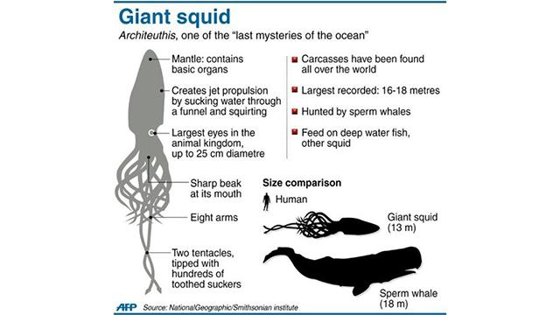

Slide 9
Giant Jellyfish
By Anthony Allen

Slide 10
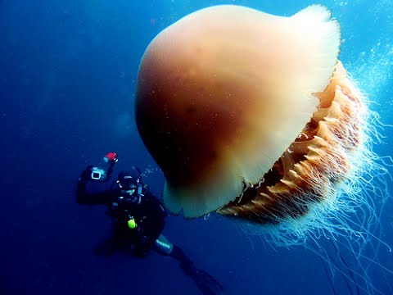
Giant Jellyfish is a Real Giant
Although able to reach a bell diameter of over 2 metres (6 ft 7 in), these jellyfish can vary greatly in size. Those found in lower latitudes are much smaller than their far northern brothers with bell about 50 centimetres (20 in) in diameter. These large creatures of the deep have been here for over 500 million
years, yet it’s possible for them to have been here 700 million years but nobody is sure. It is almost impossible to figure that out because they have no exoskeleton. Their means of a backbone is the giant bell that they use as a head. For food, they use their big tentacles. These are creatures of the deep that you really need to respect because they will ruin your day if you aren’t careful.

Slide 11
Lynx
http://jeb.biologists.org/content/214/23/3935.long clione
http://www.ncbi.nlm.nih.gov/pubmed/25414524 giant clam
http://www.ncbi.nlm.nih.gov/pmc/articles/PMC3854791/ giant squid eyes
http://blogs.ei.columbia.edu/2011/02/26/giant-jellyfish-swarms-%E2%80%93-are-humans-the-cause/ Giant Jellyfish^

